Slide 1


Paul J Phelan, CFP© | Senior Vice President
(240) 864-9117| Paul.Phelan@assuredpartners.com
Natalia Bravo | Account Executive
(301) 948-5800| Natalia.Bravo@assuredpartners.com

Slide 2








About Us
5th
11th
35
250
LARGEST P&C BROKER IN THE US
LARGEST BROKER IN THE US
STATES, 250 CITIES, 4 COUNTRIES
PHYSICAL OFFICE LOCATIONS
250+
9,200
900K
$2.25B
PRODUCTS & SERVICES
TEAM MEMBERS
HAPPY CLIENTS AND COUNTING!
IN ANNUALIZED REVENUE

Slide 3
Industry Expertise
Our Business Segments
PROPERTY & CASUALTY
EMPLOYEE BENEFITS
PERSONAL INSURANCE
RETIREMENT PLANS
AssuredPartners is one of the nation’s prominent insurance brokerage firms specializing in commercial property and casualty insurance and risk management services. For more than three decades, our property and casualty professionals have ardently provided expert consultation and strategic solutions to meet the diverse insurance needs for our clientele. We take pride in helping our clients remain financially strong.
Property
Casualty
Bonds & Surety
International Programs
Management Liability
Mergers & Acquisitions
AssuredPartners has assembled a client-focused team structure that solely focuses on employee benefits. Our practice maintains unsurpassed carrier relationships and offers a variety of solutions to maximize benefits plans, while also focusing on compliance and controlling costs for our clients.
Proprietary Health Exchange
Compliance Reporting Solution
Client Communication Portal
Certified HR Client Support
In-House ERISA Resources
Underwriting & Data Analytics
Eligibility Management
Prescription Drug Management
At AssuredPartners our client advocates take pride in recommending effective solutions with our client's best interests in mind, making sure coverage is not under-insured or paying more than necessary for coverage. We represent the leading insurance companies and have the strength to protect our clients’ significant assets.
Automobile and Recreation
Homeowner, Condo, Rental, 2nd Home
Private Client for High Net Worth
Watercraft
Fine Art and Collectibles
Jewelry, Silver and Furs
Private Aircraft
Life Insurance and Personal Umbrella
At AssuredPartners we’ve built a Financial Services Team that focuses exclusively on Corporate Retirement Plans. We work the leading recordkeepers, investment providers, and other administrators and service providers to offer a complete solution with an advisor model that equally serves the Employer and Employee.
3(21) and 3(38) Investment Advisory Services
Financial Wellness & Education for Employees to meet them where they are at in their financial journey
Access to full service 3(16) Administrators
Fiduciary Education & Plan Governance Assistance
Investment Line Up Consulting & Analytics
Compliance Assistance
Pooled Employer Plans

Slide 4


Retirement Plan Specialists
A boutique experience with the strength and resources of a national firm.
With Pensionmark you get the best of both worlds, working with an experienced independent advisor backed by a network of support specialists.
3,350
Retirement Plan Clients As of 6/1/2020
$48B
Assets Supported¹ $19B in Discretionary Assets under Management¹
310
Team Members As of 6/1/2020
60
…powered by…
Locations As of 6/11/2020
Notes:
You know AssuredPartners as an insurance broker, but because insurance brokers and retirement practices must be separated – AssuredPartners clears through Pensionmark
Pensionmark focuses on Corporate Retirement Planning, that means we’ve built out our tools to focus on employers and employees – which is different than individual planning – where most advisors focus
This meeting is about YOU though

Slide 5
2023-2024 Partners of the Americas Benefit Renewal
Strategy Discussion and Summary
For the first time in 6 years Partners of the Americas is facing a double digit renewal increase – 16.08%
Small Group Premiums are based on the ages of the individuals covered
Small group Premiums are filed the year prior to the year that they are released – 2020 rates in 2019, 2021 rates in 2020, 2022 rates in 2021, and these 2023 rates in 2022. This is important because 2022 is when CareFirst understood the impact COVID had on all of their Small Group Premiums.
Partners since 2014 when Small Group Premiums based on age were introduced has not changed the reference plan or employer/employee split for Health Insurance
Options were reviewed this year for changes to plan design and contribution strategy
2021 Partners changed the Vision and Dental coverage to The Standard in order to save premium over an increase in premium from MetLife
The coverage with The Standard on paper was the same in terms of coinsurance for services
Over the course of the last two years Partners Human Resources Team have received feedback that the reimbursements and coverage on the plan is not as robust as MetLife or other carriers have been
Research was done this year on alternative carriers and increased maximums in the plan design
2022 Partners changed policies around Short-Term Disability and Leave Banks
2023-24 Planning includes coverage for Short-Term Disability
Options are included this year to move away from The Standard with the Dental/Vision coverage

Slide 6
2023-2024 Partners of the Americas Benefit Renewal
6 Year Renewal History (2017-2023)
Partners of the Americas
 |  |  |  | 2017 |  | 2018 |  | 2019 |  | 2020 |  | 2021 |  | 2022 |  | 2023
Partners Estimated Monthly Premium |  |  |  | $9,822.01 |  | $10,080.74 |  | $12,149.07 |  | $15,991.23 |  | $28,401.84 |  | $21,338.82 |  | $33,947.25
Renewal Change at 8/1 based on enrollment at that time |  |  |  |  |  | 2.63% |  | -6.44% |  | 2.64% |  | 3.67% |  | -1.29% |  | 16.08%
Employees Covered |  |  |  | 15.00 |  | 15.00 |  | 18.00 |  | 22.00 |  | 27.00 |  | 36.00 |  | 30.00
Percentage Change in Headcount |  |  |  |  |  | 0.00% |  | 20.00% |  | 22.22% |  | 22.73% |  | 33.33% |  | -16.67%
ER/EE Breakout |  |  |  | 80/20 |  | 80/20 |  | 80/20 |  | 80/20 |  | 80/20 |  | 80/20 |  | 80/20
Reference Plan |  |  |  | BlueChoice Plus Platinum |  | BlueChoice Plus Platinum |  | BlueChoice Plus Platinum |  | BlueChoice Plus Platinum |  | BlueChoice Plus Platinum |  | BlueChoice Plus Platinum |  | BlueChoice Plus Platinum
Paul Notes: there is some variance in the Partners Estimated Monthly Premium due to enrollment types, some years had more families or younger/older employees. Bearing this in mind, I pulled the actual renewal change based on our review from the spreadsheets dating back to 2017. Overall, Partners has had tremendous employee growth, and this is the first major increase since 2017. As the next tabs lay out, a severe change in plan may not be needed at this time nor will it do much to relieve the premium increase based on the idea of funding a portion of a deductible for employees. However, it may be the year to change the employer/employee split and encourage employees to look closely at their choices and how they are spending their portion of Partners premium contribution.

Slide 7
2023-2024 Partners of the Americas Medical Renewal
Options, Discussion and Recommendations
Four main ideas from all those discussed were profiled
Renew as is at 16.08% or Change the Employer Contribution to 75% from 80% to reduce renewal to 10.23%
Move to a Single Plan Option with a High Deductible Health Plan and supply all employees with an HRA to cover the $1500 or $1600 deductible – any savings realized in premium costs is eliminated by funding the HRA (a Gold and Silver Option were reviewed)
A less dramatic plan change was considered to reduce the premium as well, but cost reduction was marginal compared to a contribution change
Partners being a DC Employer is required to the DC Health Link – this system has been confusing for many employees as they must choose from every available Platinum Option (approximately 32 plans), but it has also led to savings for many employees as well when they spend Partners premium contribution wisely. We would like to limit employees’ direct interaction with the Health Link this year and limit choices to increase efficiency
We can offer a Benefit Management System called Employee Navigator free of charge to streamline Partners enrollment processes
We’d like to narrow the 13 different plans that Partners’ employees choose today down to 4 based on plan design and duplication to simplify the process and reduce possible compliance issues
AssuredPartners would manage the DCHL on Partners behalf and feed data to ancillary lines carriers
Recommendation
If it can be sustained in Partners budget – no change in plan should be made except to possibly change the contribution and add Navigator with narrowed choices
This would keep Partners near the top of employee contributions (even among non-profits) and continue to make Partners an employer of choice through maintenance of a Platinum Plan option and a reference plan with no deductible

Slide 8
2023-2024 Partners of the Americas Medical Renewal
Options, Discussion and Recommendations
Partners of the Americas
Rates vary based on option selected
DC Health Link
Total Premium Monthly for DC Health Link*
 |  |  |  | Employer Costs |  | Employee Costs
Current June 2023 DC Health Link Premium |  |  |  | $29,245.45 |  | $5,330.16
Current Reference Plan POS BCCS Base 80/20 Split (80% of the cost of the base plan covered by employer, remaining 20% employee) |  |  |  | $33,947.25 |  | $5,237.76 |  | Option 1
Percentage Change |  |  |  | 16.08% |  | -0.32%
Difference Total Dollar Monthly |  |  |  | $4,701.80 |  | -$92.40
Difference Total Dollar Annual |  |  |  | $56,421.55 |  | -$1,108.75
Current Reference Plan POS BCCS Base 75/25 Split (75% of the cost of the base plan covered by employer, remaining 25% employee) |  |  |  | $32,236.46 |  | $7,496.84 |  | Option 2 | Recommended
Percentage Change |  |  |  | 10.23% |  | 7.41%
Difference Total Dollar Monthly |  |  |  | $2,991.01 |  | $2,166.68
Difference Total Dollar Annual |  |  |  | $35,892.15 |  | $26,000.13
Change Reference to BlueChoice Advantage Gold HRA 80/20 Split and 100% HRA Funding (80% of the cost of the base plan covered by employer, remaining 20% employee) |  |  |  | $38,074.68 |  | $7,737.42 |  | Option 3
Percentage Change |  |  |  | 30.19% |  | 8.23%
Difference Total Dollar Monthly |  |  |  | $8,829.23 |  | $2,407.26
Difference Total Dollar Annual |  |  |  | $105,950.76 |  | $28,887.12
Change Reference to BlueChoice Advantage Silver HRA 80/20 Split and 100% HRA Funding (80% of the cost of the base plan covered by employer, remaining 20% employee) |  |  |  | $34,915.89 |  | $6,828.97 |  | Option 4
Percentage Change |  |  |  | 19.39% |  | 5.12%
Difference Total Dollar Monthly |  |  |  | $5,670.44 |  | $1,498.81
Difference Total Dollar Annual |  |  |  | $68,045.26 |  | $17,985.74
*Assumptions are based on current enrollment rates
Notes:
PPO - preferred provider organization (usually most expensive)
POS - point-of-service plan (usually mid range costs)
HMO - health maintenance organization (always cheapest option)

Slide 9
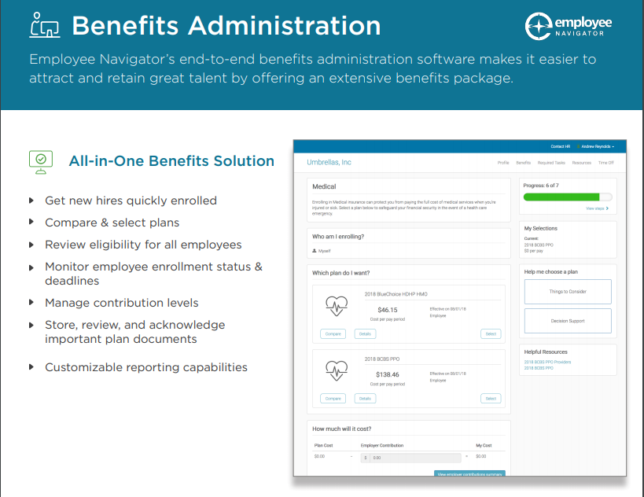
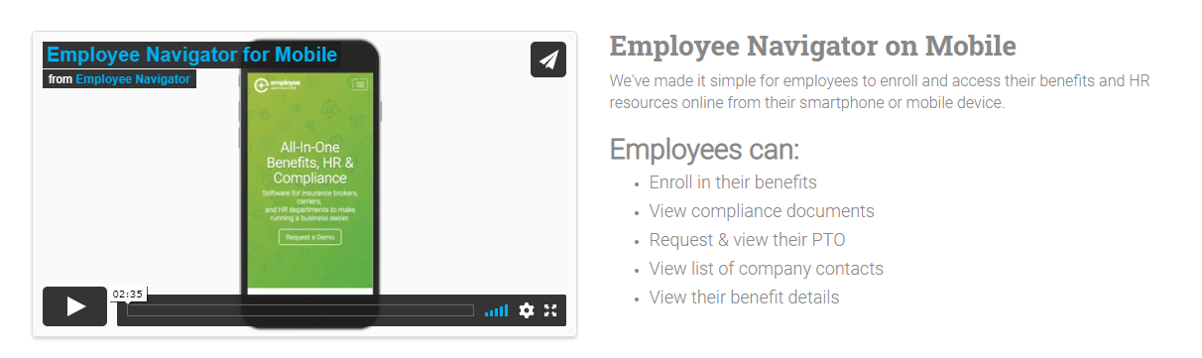
Employee Navigator
Employee Navigator should be better utilized:
Eliminate DCHL cumbersome navigation
Narrow choices to eliminate decision paralysis and possible compliance issues
Off DCHL data can feed to carriers to increase accuracy
Process can create Benefit “Report Cards” showing the value of benefits and the “hidden paycheck”
Reporting can be reviewed by our team for deduction errors and standardized after O/E for payroll uploads

Slide 10
2023-2024 Partners of the Americas Dental/Vision Renewal
Education and Recommendation
Dental and Vision Plans “strength” is based on 3 main factors
Network – how widely is it accepted and behind the scenes how much of it owned by the carrier and how much is rented
Coinsurance and reimbursement schedules – what percentage of a service is covered and is it covered according to a carrier’s contract or the Usual Customary & Reasonable charges in a given area
Plan Maximum – what is the most the plan will pay in total for a plan year
Three carriers we find with strong networks and wide acceptance are Principal, Guardian and MetLife
Currently our recommendation is Guardian
Prior great experience with clients like Partners
Plans with $15000 maximum matching all other benefits are 3.0% below the current rates with The Standard
Guardian can use either VSP or Davis Vision Network for vision which are the two most widely accepted networks in the country
Principal. Met and Unum also respnded with alternatives
We also recommend moving Life/LTD/STD coverage to the carrier chosen for Dental and Vision for bundling discounts and continuity

Slide 11
2023-2024 Partners of the Americas Dental/Vision Renewal
Education and Recommendation
Ancilliary Quote Comparison Prepared for Partners of the Americas Effective Date: 08/01/2023
 | Current | Renewal |  | Alternate |  | Alternate |  | Alternate |  | Alternate
 | The Standard | The Standard |  | Principal |  | Guardian |  | MetLife |  | Unum
Dental | $2,235.00 | $2,435.96 | $2,934.64 | $2,206.47 | $2,438.33 | $2,167.95 | $2,838.18 | $2,024.50 | $2,320.01 | $2,285.89 | $2,708.30
Vision | $316.60 | $339.28 |  | $310.22 |  | $253.28 |  | $314.48 |  | $375.71
Life | $467.25 | $443.89 |  | $462.80 |  | $445.00 |  | $436.10 |  | $480.60
LTD | $463.55 | $463.55 |  | $478.53 |  | $478.53 |  | $513.62 |  | $606.13
STD |  | $1,325.53 |  | $1,097.45 |  | $914.58 |  | $1,211.77 |  | $1,326.08
Total Monthly | $3,482.40 | $5,008.21 | $5,506.89 | $4,555.46 | $4,787.32 | $4,259.34 | $4,929.57 | $4,500.46 | $4,795.97 | $5,074.42 | $5,496.83
Total Annual | $41,788.79 | $60,098.53 | $66,082.69 | $54,665.56 | $57,447.88 | $51,112.03 | $59,154.79 | $54,005.55 | $57,551.67 | $60,892.98 | $65,961.90
% Difference | - | 43.81% | 40.42% | 30.81% | 26.06% | 22.31% | 28.90% | 22.35% | 27.44% | 37.38% | 40.86%
Annual $ Difference | - | $18,309.74 | $24,293.90 | $12,876.77 | $15,659.09 | $9,323.23 | $17,365.99 | $12,216.76 | $15,762.88 | $19,104.19 | $24,173.11
Notes | If STD is added there is a 5% discount for LTD. | Dental : 100/80/50 $1,500 max | Dental : 100/90/60 $2,000 max | Dental : 100/80/50 $1,500 max | Dental : 100/90/60 100/80/50 $2,000 max | Dental : 100/80/50 $1,500 max | Dental : 100/100/60 $2,000 max | Dental : 100/80/50 $1,500 max | Dental : 100/90/60 $2,000 max | Dental : 100/80/50 $1,000 max | Dental : 100/80/50 $1,500 max

Slide 12
2023-2024 Partners of the Americas Benefit Renewal
Timeline for Renewal 2023-24
Open Enrollment to be conducted week of 6/19-6/30
DCHL requires Open Enrollment completion by 7/13
Running Open Enrollment early allows Partners’ Employees to avoid the 4th of July as a Holiday and possible vacation week
Navigator will allow Partners and AssuredPartners to monitor and track employee completion of the process
New cards will be expected to be sent to employees prior to 8/1/23

Slide 13

Consulting & Analytics
Voluntary Benefits
Property & Casualty
Benefits Administration
Population health management
Medical & Rx analytics
Plan disruption analysis
Employee retention strategies
Predictive modeling
Medical intelligence
Data warehouse w/ 40M+ member lives
Critical Illness, Accident, Hospital Indemnity
Customized programs that compliment medical plan
Integrated administration and billing
Enrollment support
Individual Disability Insurance (IDI)
Whole & Universal Life
Intangible/tangible assets
Bonds & surety
Workers' compensation claims management
Risk control
Return to work
Employment practices liability
Experience Mod predictions
Drug testing
Online enrollment platform
Defined contribution options
Eligibility & billing administration
Reconciled and consolidated billing
FSA, COBRA, HRA administration
Real-time Admin panel, Employee Portal
Mobile apps
Compliance management, ADA, FMLA
Pharmacy & Analytics
Compliance
Communication
Executive Benefits
Custom PBM & Clinical Programs
Pharmacy Coalition Drug Purchasing Tool
Clinical Care Management
RFP / Vendor Selection
Contract Review and Negotiation
Market Check Analysis
Auditing and Clinical Reviews
ERISA Attorney led compliance department
ACA & DOL compliance tools
1094/1095 Filing
5500’s, COBRA, HIPAA, FMLA, ERISA,
TEFRA/DEFRA, Sect 125, 105(h), 79, 152 SMMs, SARs, SPDs, Compliance Calendar
Employee handbook assistance or creation
Custom branded communication strategy
Fully-staffed communications department
Total compensation statements
Mailing & fulfillment center
Branded benefit guides, postcards, newsletters, videos, apps
Executive benefit plans to attract top talent
Retirement plans
Business succession planning
Wealth preservation
Life and disability plans
Individual Disability Insurance
Executive long-term care
Mergers & Acquisitions
Employee Advocacy
Personal Insurance
Brokerage
Diagnostic review & recommendation
Administrative & executive mediation
Turn-key employee benefits operation
Pre & post-investment analysis
Employee call center
Escalated claims resolution
Dedicated 800 number and email
Liaison between employee and carrier
Telephonic support for over 200 languages
Personalized risk management
Coverage evaluation
Personal auto/home/life, etc.
HCE program placement
Asset protection
Future planning
Full brokerage & plan design
Forecasting & modeling
Claims & Billing Assistance
Negotiation
Contractual analysis
Benchmarking

